Slide 1
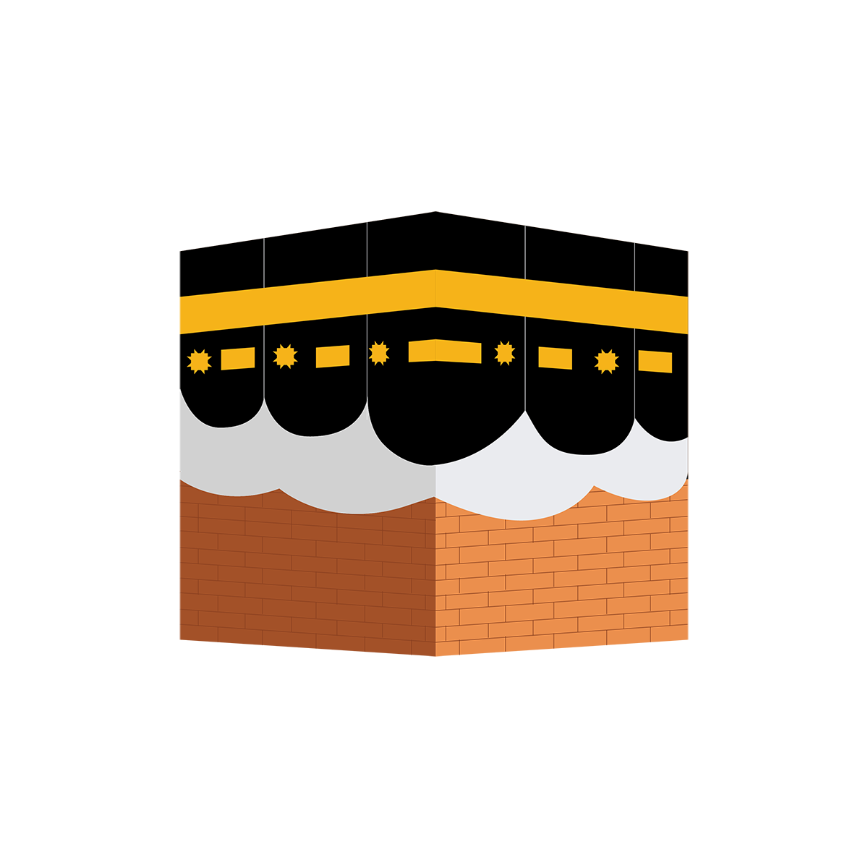


HAJJ TERMINLOGY SUMMARY


Slide 2
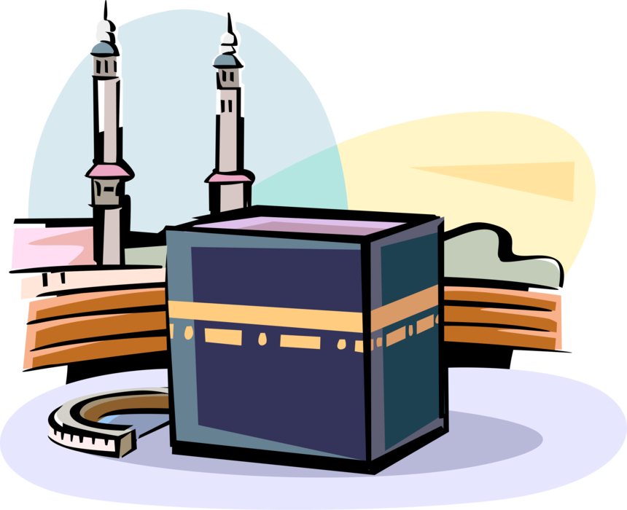
HAJJ
A pillar of Islam that has to be carried out by people who have enough money to do so. Hajj is a journey during Zul Hijjah to Makkah and surroundings to perform certain actions of worship to Allah following the example of Ibrahim Alayhis salam.

Slide 3
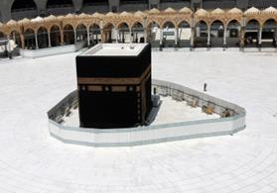
KA’BAH
TAWAAF
The House of Allah – situated in Makkah. It is a square building covered with a black sheet.
Circling around the Ka’bah 7 times.

Slide 4
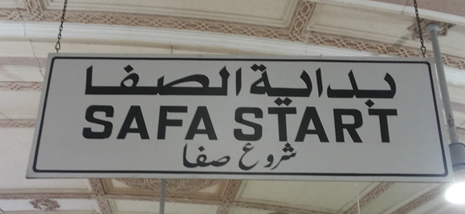
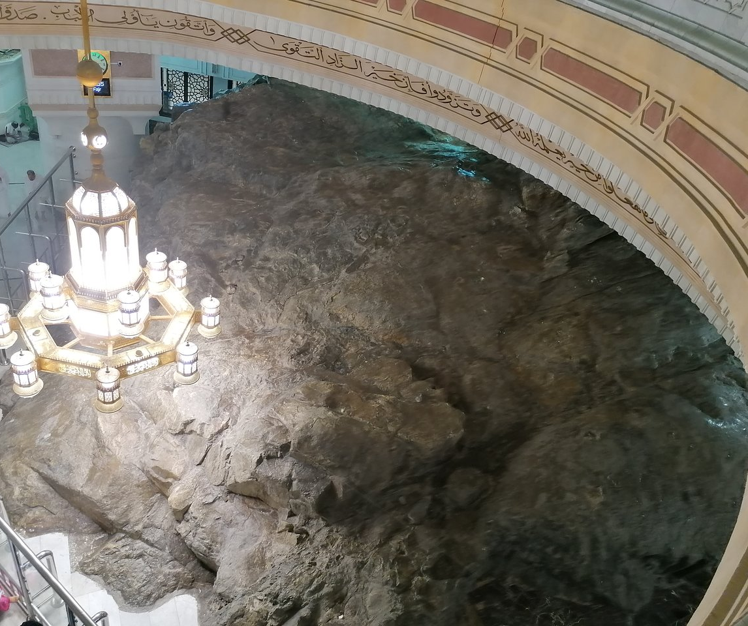
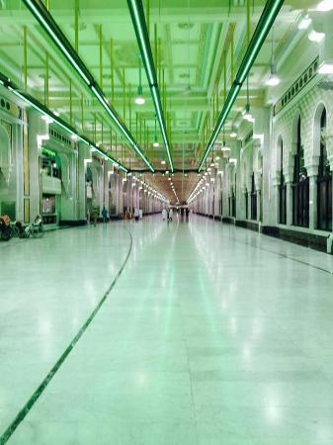
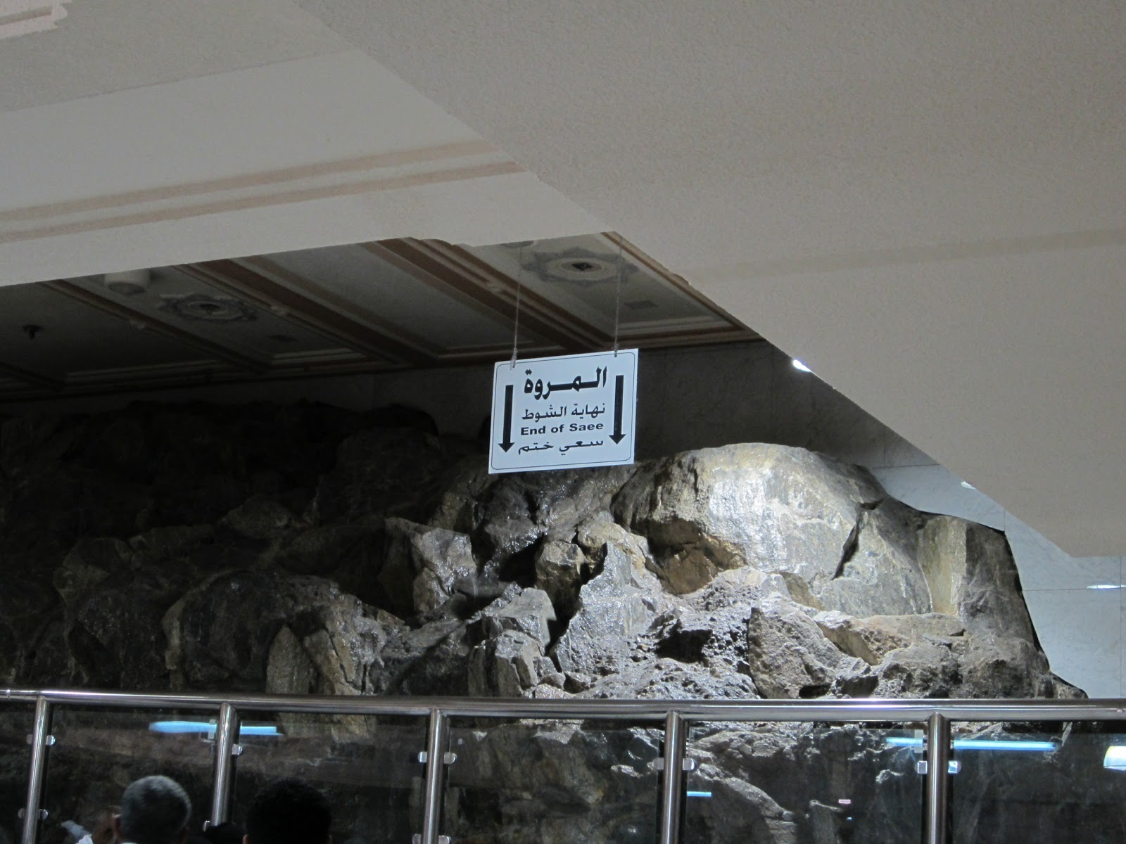
SA’EE
Walking/Running between Safa and Marwah.

Slide 5
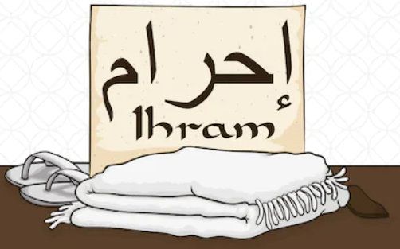
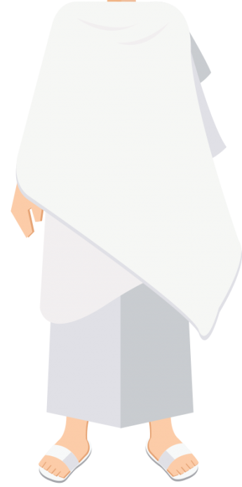
IHRAAM
A state in which a person is in before entering Makkah where certain actions are not allowed. Men wear 2 white sheets.
Women do not have a specific type of clothing to wear.

Slide 6
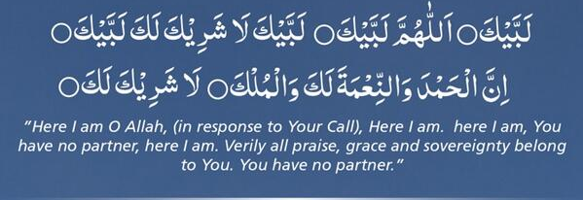
TALBIYAH
A dua that the people on Hajj read often which means “I am present, Oh Allah”

Slide 7
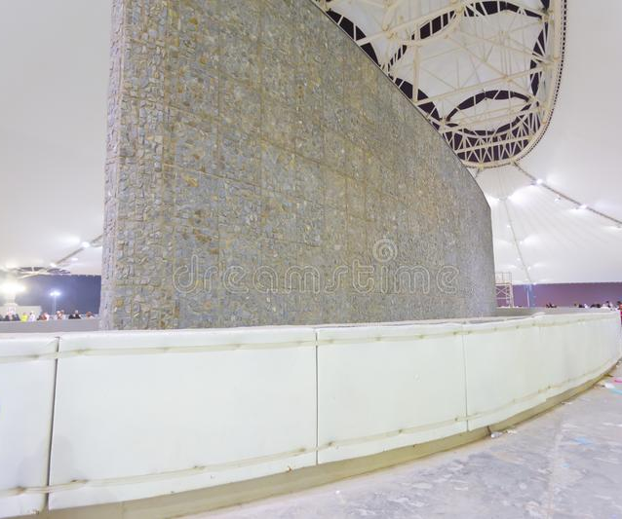
JAMARAAT
The 3 Pillars in Mina which are stoned by the people on Hajj that take the place of Shaytaan which Ibrahim Alayhis Salaam stoned.

Slide 8
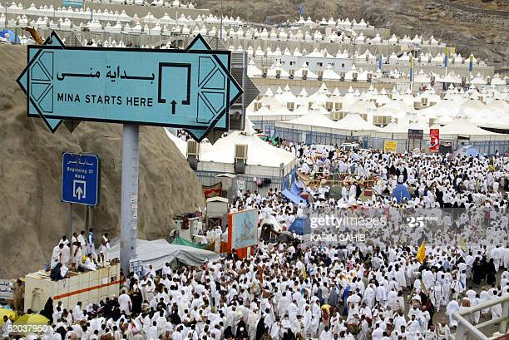
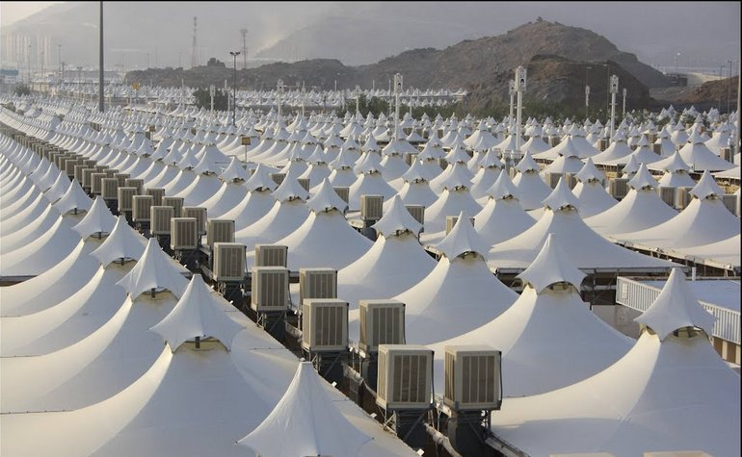
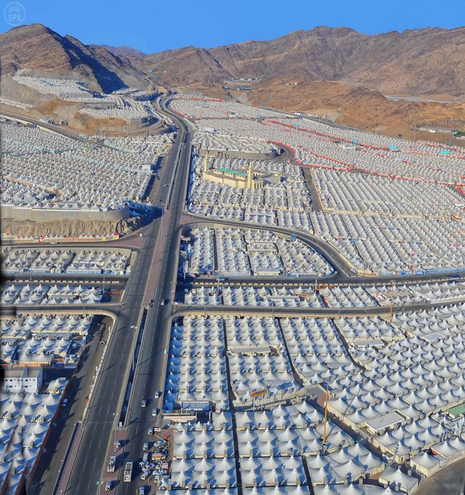
MINA
A tent city which is 6km from Makkah where people on Hajj spend Day 1, 3, 4 and 5 completing various actions. The Jamaraat are in Mina.

Slide 9
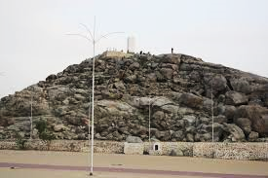
ARAFAH
Arafah is the blessed area where people on Hajj spend the main day of Hajj. Spending time in Arafah is compulsory on Hajj. This is the 9th of Zul Hijjah / Day 2. The main act of worship they carry out here is Dua.

Slide 10
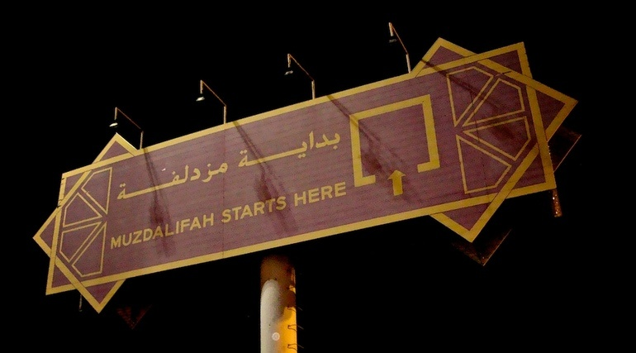
MUZDALIFAH
Muzdalifah is the blessed area where people on Hajj spend the night of 9th Zul Hijjah (before 10th) to collect the stones they need to stone the Shaytaan. They sleep in the open area under the stars.

Slide 11




This summary of the terminologies of Hajj was created by Madrasah Teacher.
www.madrasahteacher.wordpress.com
@madrasahteacher
@madrasahteacher
+27 78 696 4868

